Slide 1

The Simulation Architecture Sessions
Simulation Engines - The Heart Of The Sim
Paul Scheps
8/29/18
Notes:
First in a series of two sessions – the idea is to build off of the mini-simulation I have built here to further some interesting topics
Geared towards understanding the basics of simulation with some focus on C++ code of the mini-simulation

Slide 2

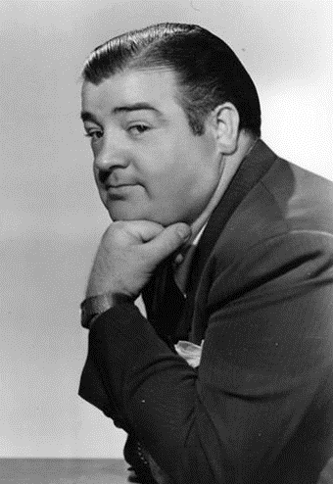
Simulations Approximate Reality
Who Is On First!
What Are You Askin’ Me For?
I’m Not Askin’ You I’m Tellin’ You! Who Is On First!
I’m Asking You! Who Is On First?
Notes:
Simulations approximate reality – they are often used to represent something in the real world.
A simple example from the real-world - take this conversation between the legendary comics Abbott and Costello.
Abbott tells Costello “who is on first”. Costello hears this and formulates his retort – “what are you askin me for?” It’s a back and forth from the Who’s On First somedy skit….moving now into the virtual world….

Slide 3
Simulations Approximate Reality
Tick!
Abbott Component
Engine
Costello Component
Who Is On First!
Process Message m1
Abbott Message m1
Process Message m2
Abbott Message m1
Costello Message m2
Costello Message m2
POP!
PUSH!
Abbott Message m3
Abbott Message m3
PUSH!
POP!
Message Queue
POP!
PUSH!
Inputs
Inputs
Notes:
That same conversation between Abbott and Costello can be represented by the above simple simulation. The simulation constructs of the Inputs, Engine and MessageQueue will be discussed later but at a high level….describe message flow
So for this lunch and learn I have created this very simulation – essentially a simulation of the Who’s On First dialog between Abbott and Costello

Slide 4
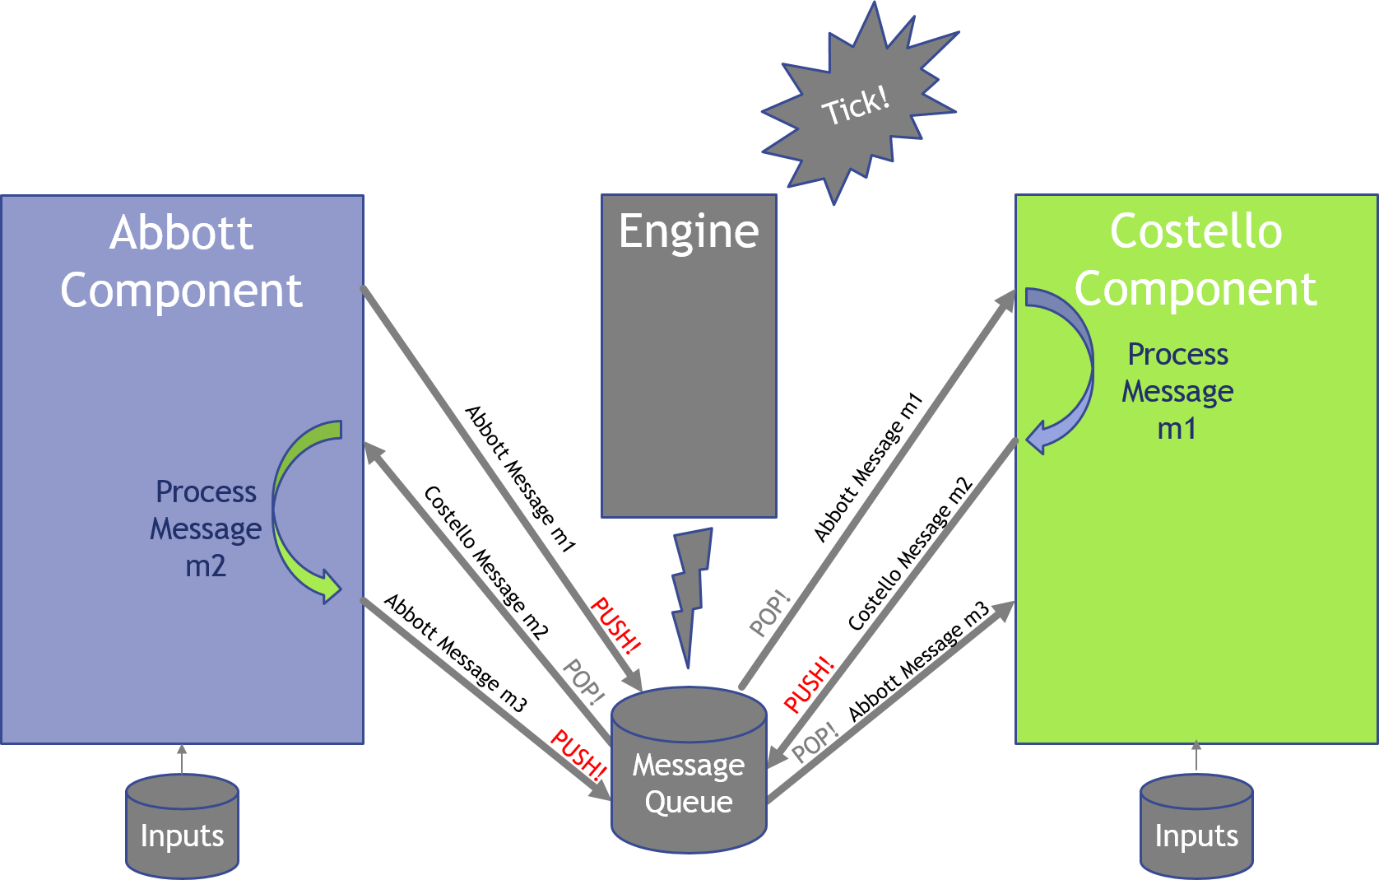
What’s A Sim Made Of?
Components
  Main players in the simulated environment
  Contains the primary logic and functionality in the simulation
  Sends and receives messages from other components
  Chooses the messages it wants to receive through subscription to topics
Notes:
Components you are familiar with – SSTRESS, ARES, C3ISim etc…
Pushes messages onto the Message Queue
The Engine manages the subscriptions and message forwarding but more about that later

Slide 5
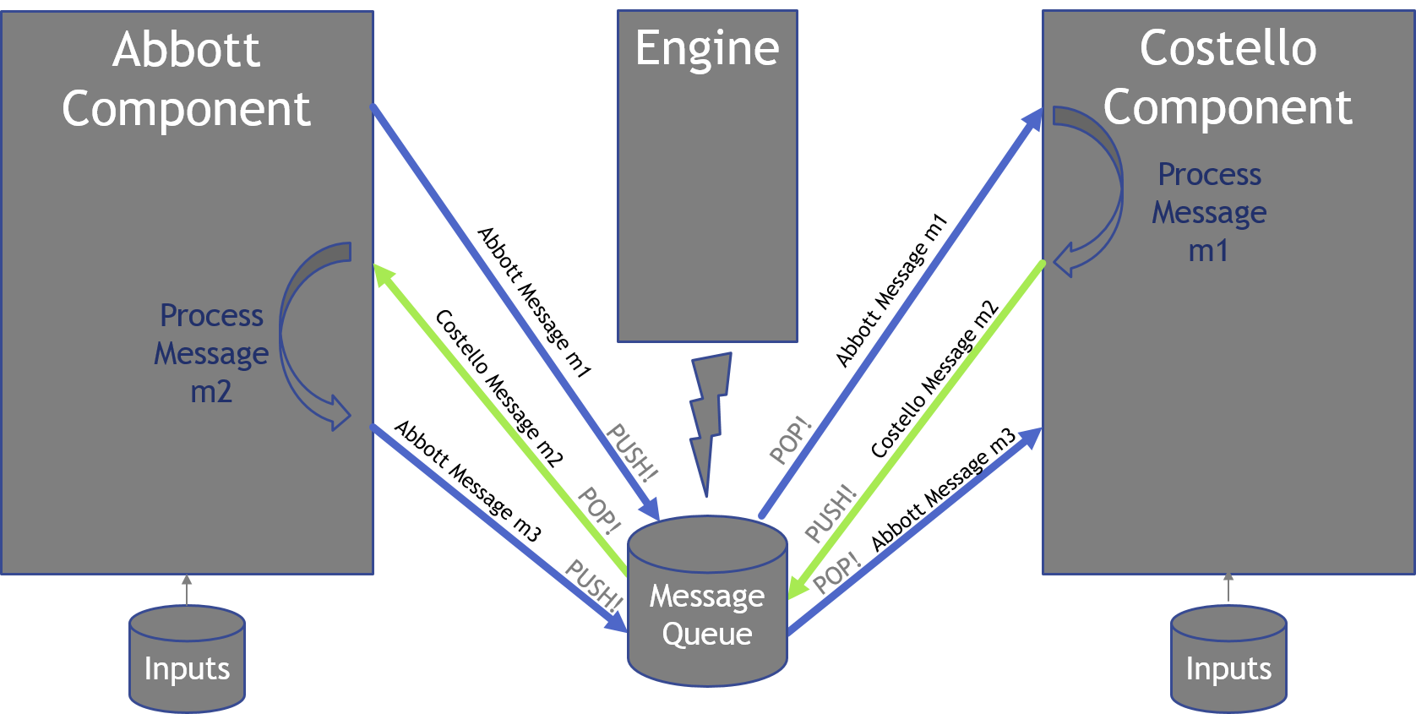
What’s A Sim Made Of?
Messages
  Primary communication between components
  Contains a payload, a send time and a topic
Notes:
In the case of our simple sim here – the message payload will simply contain a line from the script and the send time will be a parameter that we read in that controls the flow of the messages – managed by the Engine

Slide 6
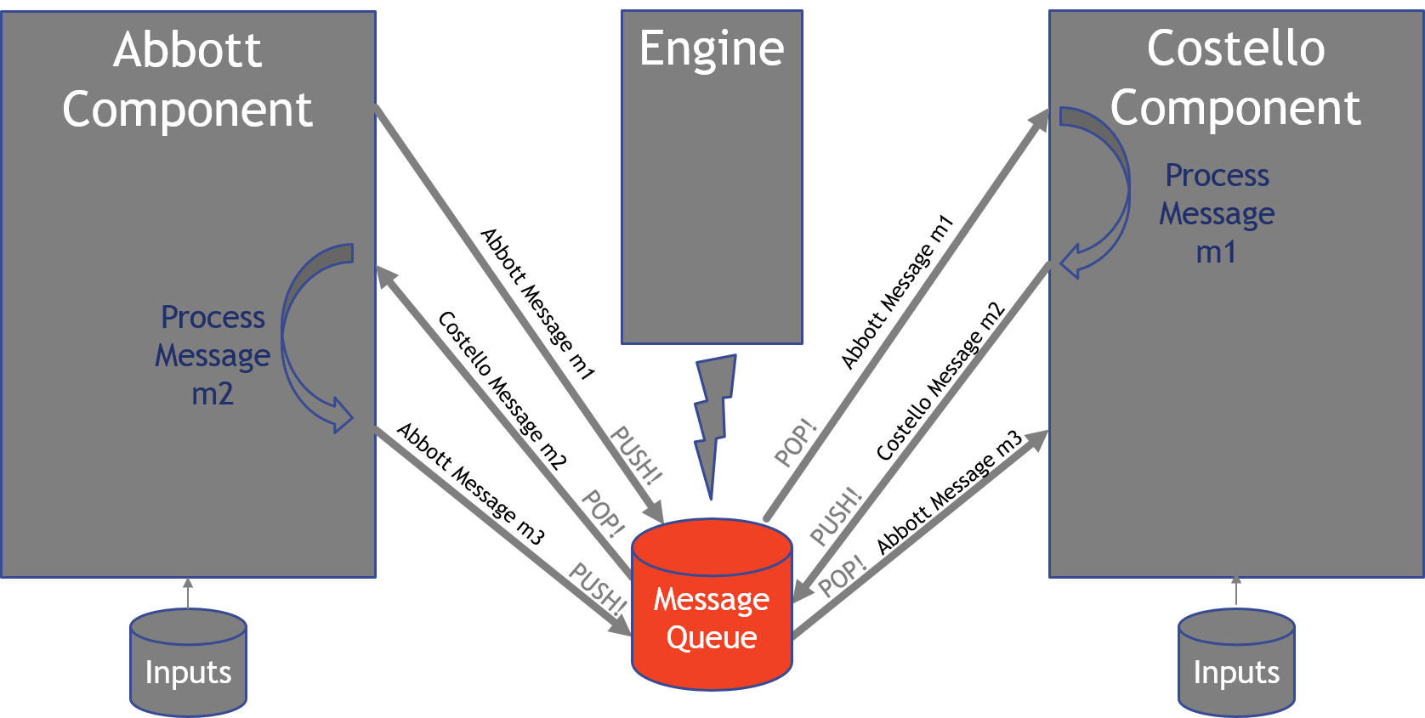
What’s A Sim Made Of?
Message Queue
  A list of messages from the components to each other that grows and shrinks as the simulation moves along in time
Notes:
A double ended queue that messages can be pushed on and popped off again controlled by the Engine

Slide 7
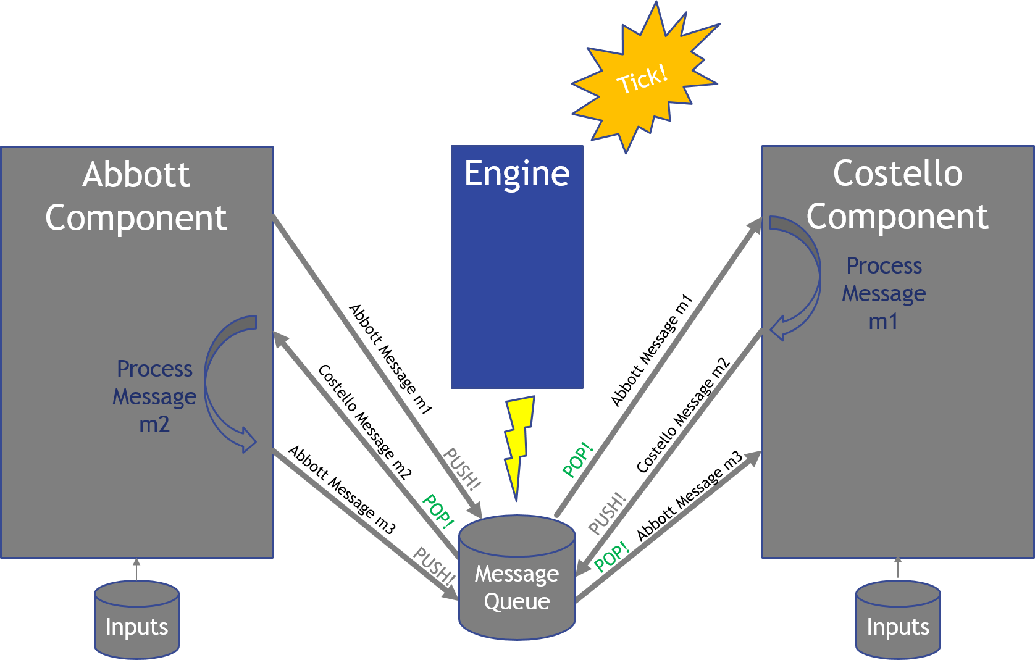
What’s A Sim Made Of?
Engine
  Registers and maintains a list of participating components
  Registers component subscription desires
  Pops messages off the message queue and relays messages between components based on subscriptions
  Regulates the timing and flow of messages
Notes:
The engine is the heart of the simulation – responsible for moving things along and the home of the main execution loop
Registers players and their subscriptions
Controls the message routing and the flow/timing of messages

Slide 8
What’s A Sim Made Of?
Engine Execution Loop
Check Message Queue
Pop Message
Empty?
Yes
No
Exit!
Is sendTime In The Future?
Route Message
No
Yes
Sleep
Notes:
The main execution loop is the primary persistent process in the simulation.
The sendTime is variable.

Slide 9
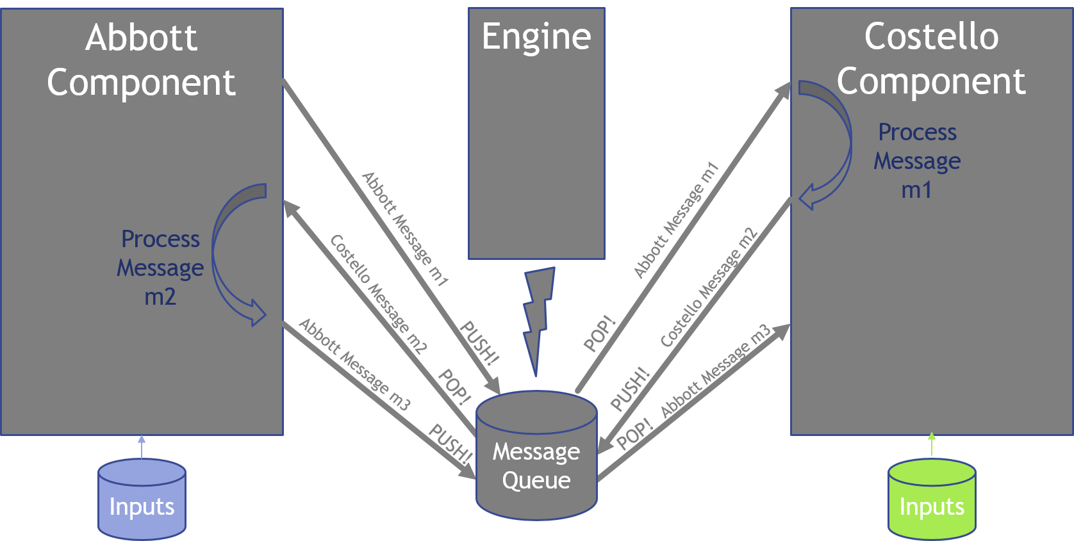
What’s A Sim Made Of?
Inputs
  Input parameters that dictate the behavior of the simulation and alleviate the need to rebuild to change behavior
Notes:
For our simple simulation – there are inputs for who is playing, their subscriptions, their comedic scripts and the comedic timing – more on the inputs later

Slide 10
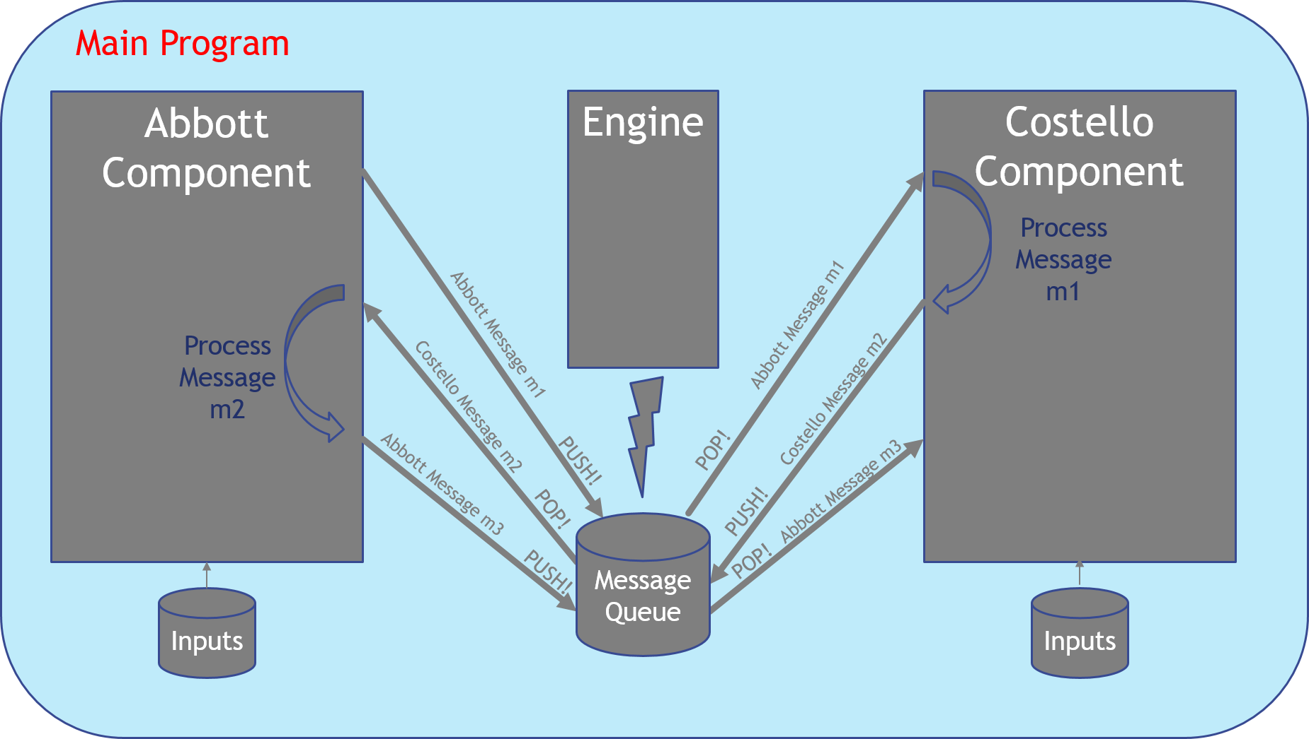
What’s A Sim Made Of?
Main Program
  The task list for the simulation
    Instantiates the components
    Instantiates the engine
    Executes the main loop of message passing
    Exits when the message queue is empty or upon error
Notes:
The main program (main.cpp) creates and uses the constituents of the simulation – think of it as the main task list for what the simulation is attempting to accomplish. Main is the entry point of execution.

Slide 11
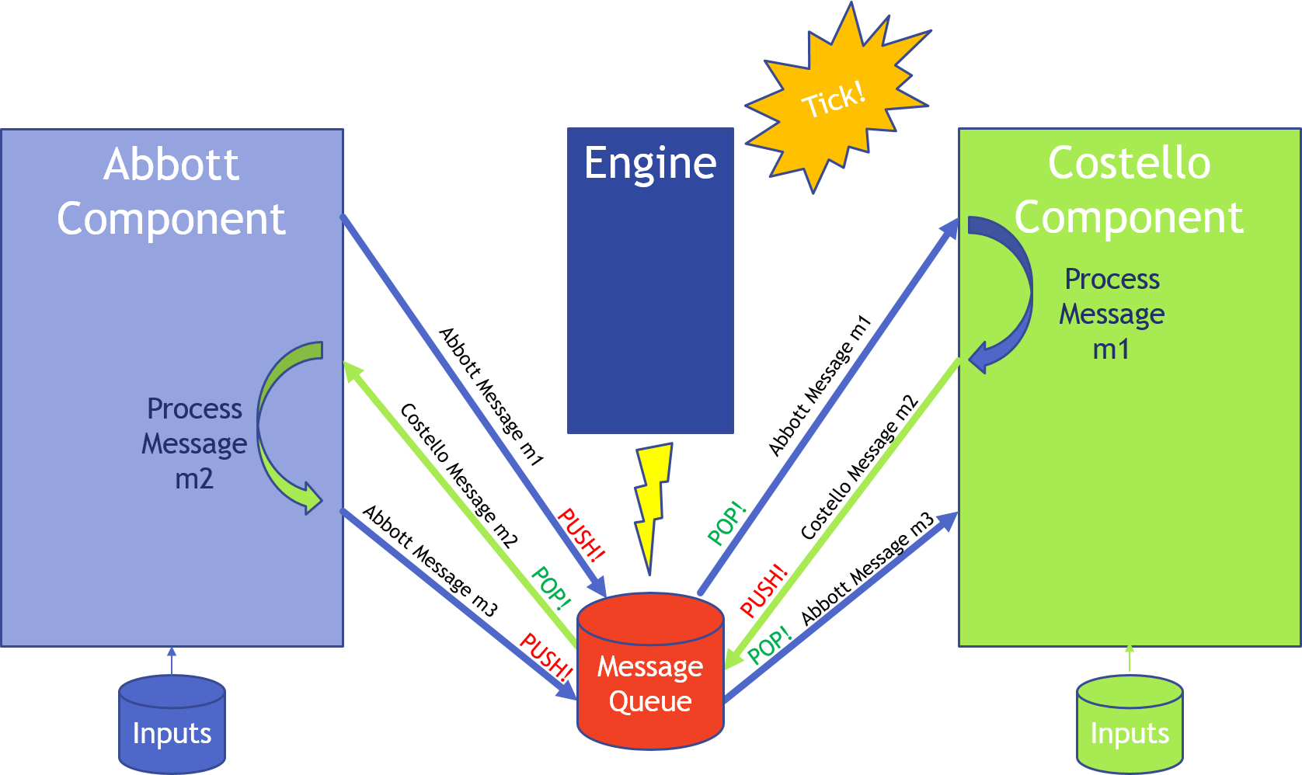
Introducing WOFSim!
A simulation representing the legendary comedy skit between Abbott and Costello
Main Program

Slide 12




Introducing WOFSim!
A single threaded C++ application
  Developed within the TT&T Centos VM
Uses some convenient C++11 functions
  auto keyword type interpreter
  chrono for time points
  delegating constructors
Uses simple factory and singleton design patterns
Depends on “espeak” which is built-in to many Linux distributions
Documentation automagically generated by Doxygen
Configuration managed in Git
Hosted on the LM Space Gitlab instance

Slide 13
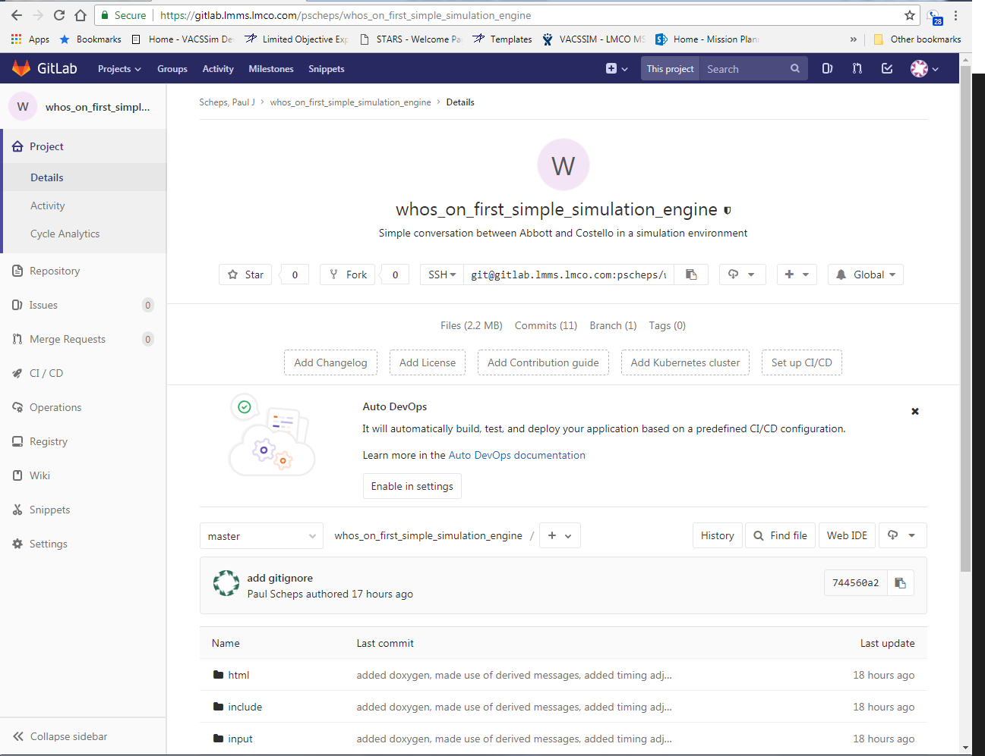
Where Is The Source
Hosted on LM Space Gitlab instance
  https://gitlab.lmms.lmco.com/pscheps/whos_on_first_simple_simulation_engine

Slide 14
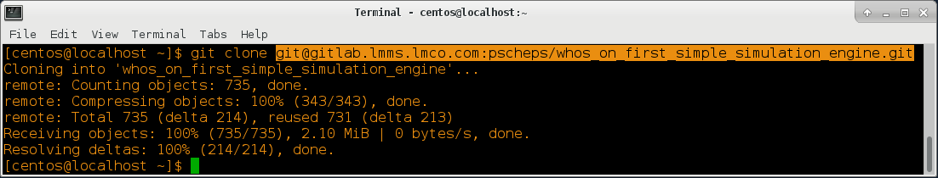
How To Get The Source
Clone Gitlab repo from Linux/PuTTY
  git clone git@gitlab.lmms.lmco.com:pscheps/whos_on_first_simple_simulation_engine.git

Slide 15
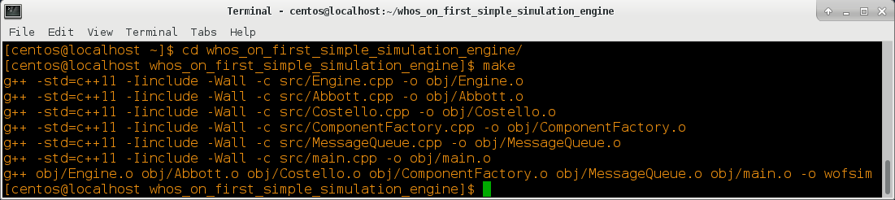
How To Build
Execute make from Linux or PuTTY – uses simple Makefile to gather source and headers, produce objects and link into an executable
  cd whos_on_first_simple_simulation_engine/
  make

Slide 16
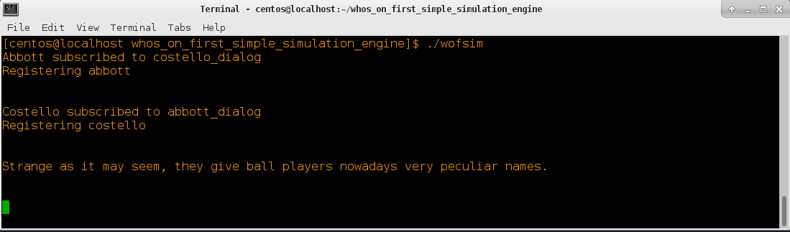
How To Run
Invoke executable from Linux or PuTTY
  ./wofsim

Slide 17
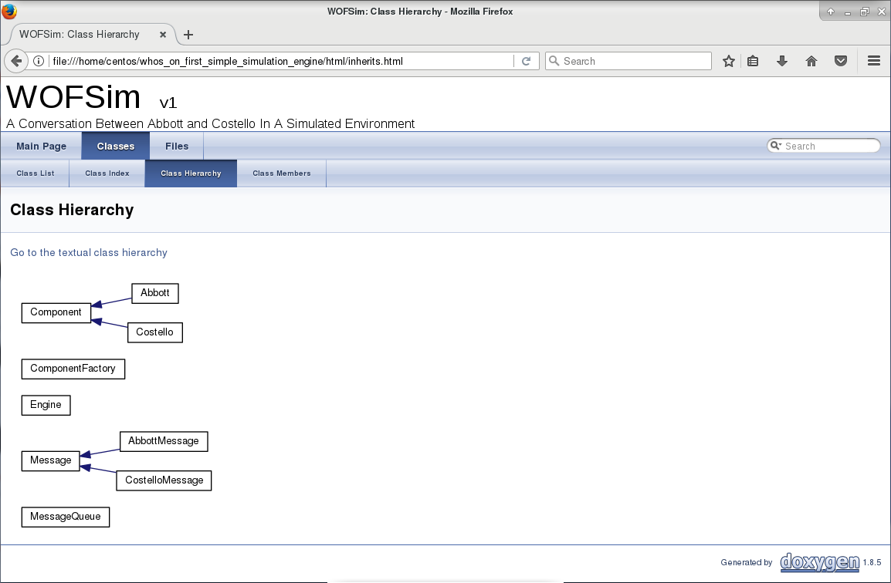
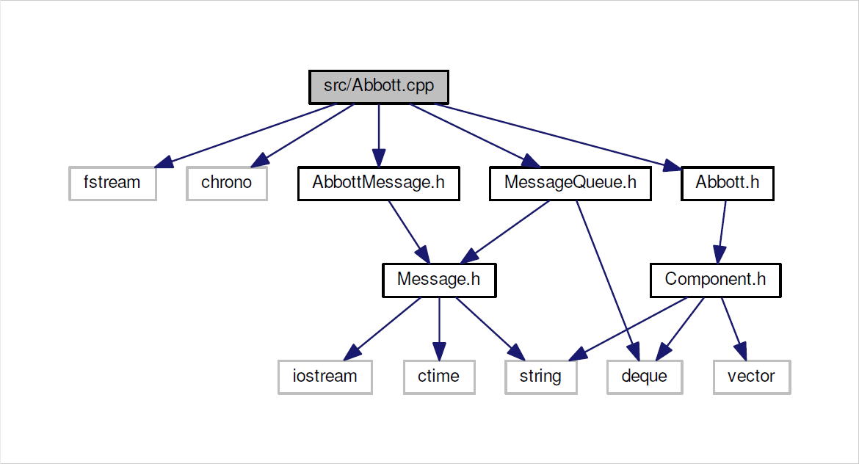
How To Generate Documentation
Uses Doxygen and configuration contained within Doxyfile to generate class/call diagrams in html and LaTeX styled PDFs
From Linux or PuTTY
  ./doxygen
  firefox html/index.html

Slide 18
WOFSim Teardown - Inputs
Parametric Inputs
  sim.components – a listing of component names that are playing that is used by component factory to build components
  <component_name>.sub – each component has a list of topics it subscribes to
  <component_name>.timing – each component adds a timing offset to messages it sends
  <component_name>.lines – each component reads and stores its script

Slide 19
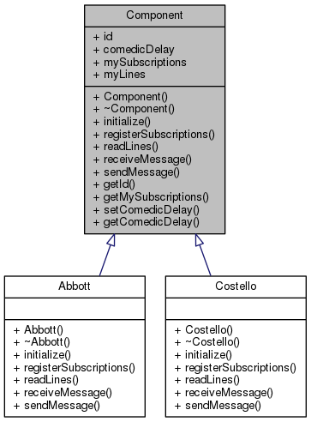
WOFSim Teardown - Classes
Component
Notes:
The main player…
comedicDelay is the offset added to the messages which is read from the timing file
mySubscriptions is a vector containing all of the component’s desired topics to receive
myLines is a vector containing all of the component’s lines for the skit
registerSubscriptions pulls subs from input
readLines pulls lines from input

Slide 20
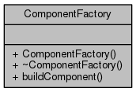
WOFSim Teardown - Classes
Component Factory
Notes:
Uses the factory design pattern - invoked by the main program to produce components – the factory serves as a knowledge base and knows how to build components. Maybe some objects need a reference to some other object X, which the factory can provide, but in main where you want to construct A, B or C can't or shouldn't have access to X. This is where a factory is advantageous. In this case – the factory is extremely simplistic and perhaps is overkill.

Slide 21
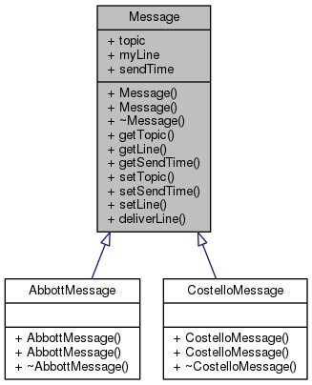
WOFSim Teardown - Classes
Message
Notes:
myLine is the line of the skit packed into the message
sendTime is the time delay which is set in the timing file – 0 delay is an asynchronous message

Slide 22
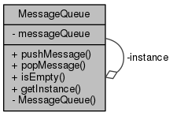
WOFSim Teardown - Classes
MessageQueue
Notes:
Uses the singleton design pattern – when Instance() is called – if it does not already exist it is statically created. Static variables can be accessed anywhere within the program so for a message queue this can be quite advantageous. Prevents passing the message queue around and making copies.

Slide 23
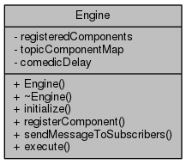
WOFSim Teardown - Classes
Engine
Notes:
The heart of the sim…
registeredComponents is a vector of components playing
topicComponentMap is a map of components playing to the subscriptions that they have requested
sendMessageToSubscribers routes message to components that have registered to the message topic
execute is the main execution loop and controls the message timing and flow

Slide 24
WOFSim Teardown – Sequence Diagrams
Main
ComponentFactory
Engine
Component
Read sim.components
buildComponent()
return component
initialize()
Read sim.timing
initialize()
Read subscriptions
Read lines
registerComponent()
Map Components To Subscriptions
setComedicDelay()
execute()
Notes:
Within initialization of Abbott – since he starts the script – the first message is pushed BEFORE the main execution loop

Slide 25
WOFSim Teardown – Sequence Diagrams
Component A
MessageQueue
Component B
Engine
pushMessage()
Instance()
execute()
Check MessageQueue
popMessage()
Check timing
Sleep
sendMessageToSubscribers()
receiveMessage()
pushMessage()
Notes:
Within initialization of Abbott – since he starts the script – the first message is pushed BEFORE the main execution loop

Slide 26

Next Session – WOFSim_v2.0
Abbott and Costello talk over the phone!
Develops the concepts of distributed simulation and socket programming with a focus on concurrency

Slide 27

Questions??

